Slide 1
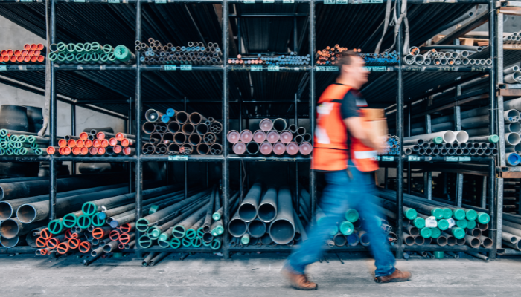

Pipes Inventory Management

Slide 2

Project Leadership
Sharat Manikonda
Director at Innodatatics and Sponsor
linkedin.com/in/sharat-chandra

Slide 3
Team Members
Name: K. Aravind
www.linkedin.com/in/k-aravind-79b331251

Slide 4

Contents
Business objective
Business Constraints
Project Architecture
Data collection and details
Exploratory Data Analysis
Visualization
Modeling
Evaluation
Deployment
Notes:
Change

Slide 5
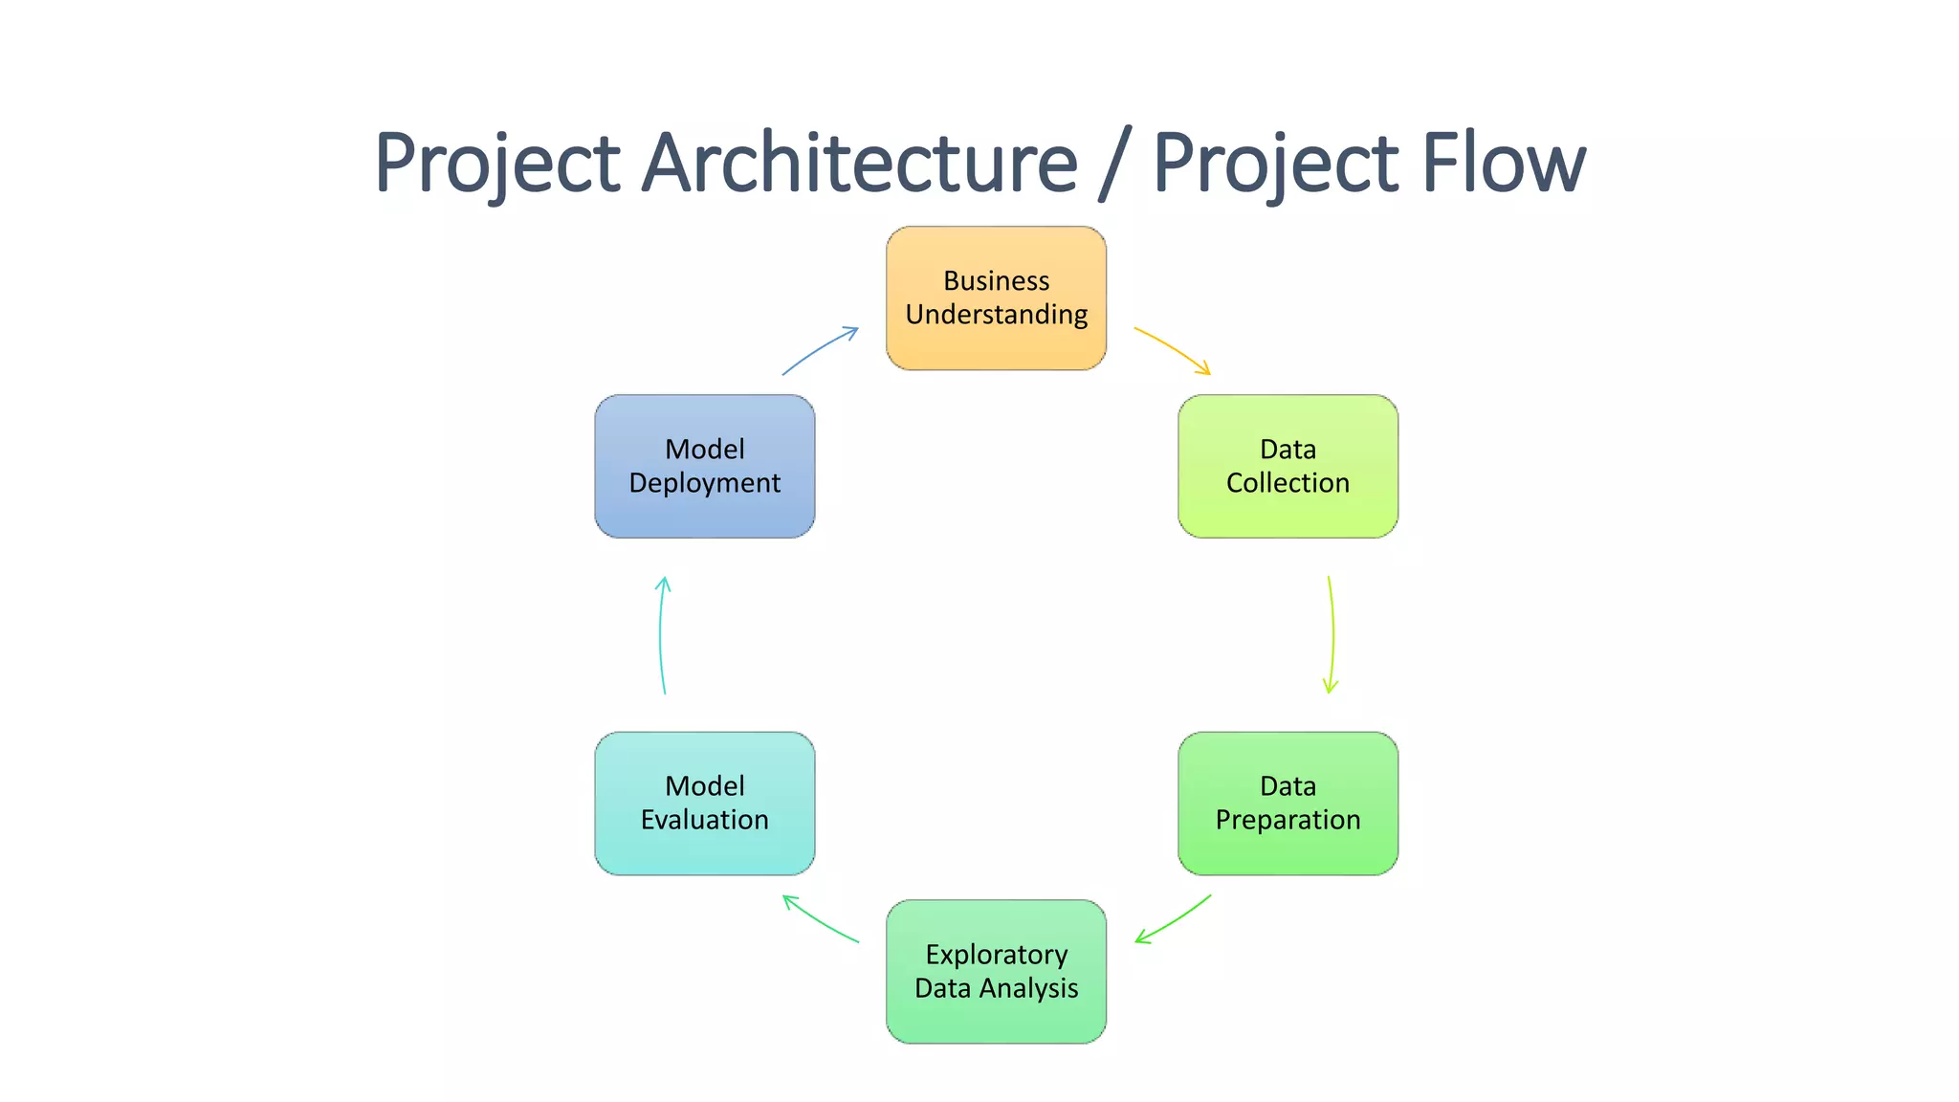
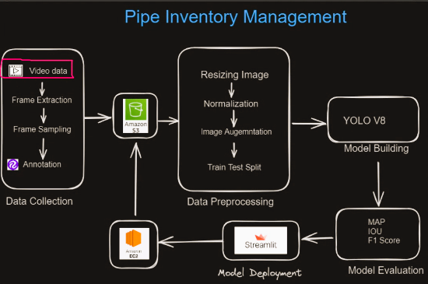
Project Overview and Scope

Slide 6

Business Problem
Counting manually and keeping track of the number of steel
pipes of different dimensions and shapes is cumbersome
process

Slide 7
Business Objective
Objective
Constraints
Minimize operational cost
Maximize Efficiency
Minimize manual effort

Slide 8
CRISP-ML(Q) Methodology
There are six stages of CRISP-ML(Q) Methodology
1.Business and data understanding
2.Data preparation
3.model building
4.Model evaluation
5.Model deployment
6.Monitoring and maintenance

Slide 9
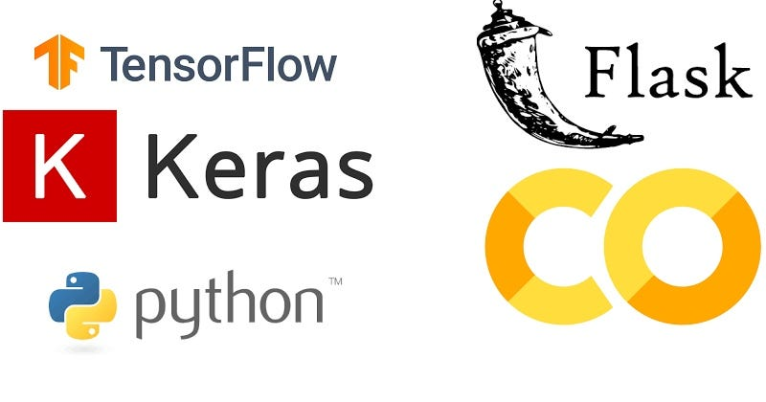
Technical Stacks
Google Colab
Tensorflow
Jupyter Notebook
Roboflow
Ultralytics
Streamlit/ Flask
OpenCV
Anaconda Prompt
PILLOW

Slide 10

Data Collection and Understanding
Data collection is a primary data provided by client in a video in a .MOV format.
Data consisting a video of bunch of pipes with different dimensions and shapes.
Extracted a total of 1870 images with 60 FPS in .jpg format from the provided video.
Out of these 852 images are selected for train set, 96 images for valid s and 82 images for test set.

Slide 11

System Requirements
RAM – 8GB
Processor – i5
Storage – 512 GB
GPU – RTX 3080

Slide 12
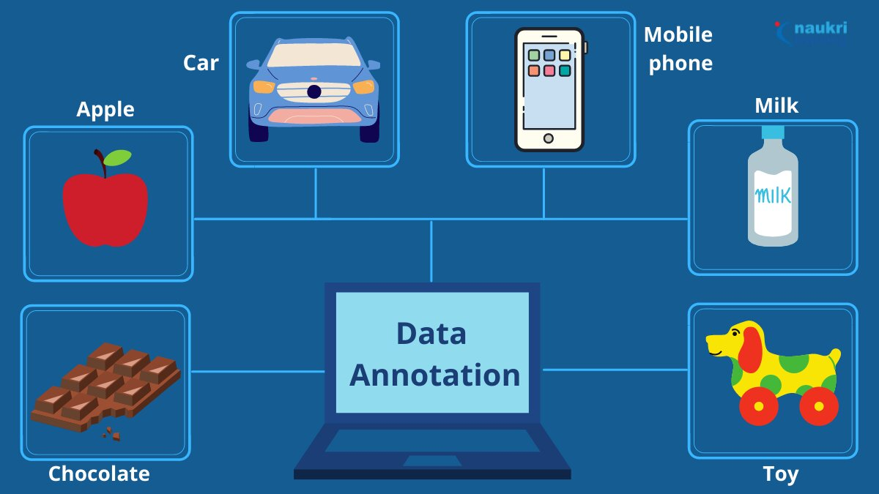
Data Preperation
Data Annotation:
Data annotation is the performed in Roboflow tool.
Used Polygon bounding for all the pipes in images.
Labelled them with relevant tags.
Labelling it's dimension and shape for each pipe.
Data Pre-processing :
Image Re-sizing for the Image data after annotation following pre-processing all the images are resized to a fixed size of 512 * 512 .
Notes:
Keep observations

Slide 13
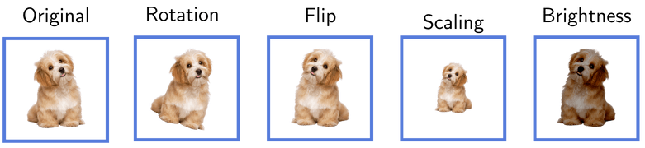
Data Augmentation
Data augmentation used for artificially increasing the training set by creating modified copies of dataset using existing data.
Data Augmentation is performed after Preprocessing Images.
The following augmentation was applied:
50% probability of horizontal flip
50% probability of vertical flip
Randomly crop between 0 and 26 percent of the image
Random rotation of between -11 and +11 degrees
Random brigthness adjustment of between -25 and +25 percent
Shearing images
Normalization :
Normalization is performed to prepare the dataset for model building tasks by ensuring that both images and their annotations are in normalized format.
Notes:
Add graphical

Slide 14
Model Building
YOLOV8:
I have built YOLOv8 model by using it’s YOLOV8n (nano) model by taking image size (imgsz) as 512, batch as 20 and trained it for 10 epochs and got a MAP50 value as 0.559.
YOLOV5:
I have built YOLOv5 model by using it’s YOLOV5s (small) model by taking image size (imgsz) as 640, batch as 16 and trained it for 19 epochs and got a MAP50 value as 0.217.
DeTr:
I have built DeTr model by using it’s facebook/detr-resnet-50 model by taking image size (imgsz) as 624, batch as 1 and trained it for 11 epochs and got a AP50 value as 0.038.
Notes:
classification is the task of predicting a discrete class label. Regression is the task of predicting a continuous quantity.
What is classification techniques in machine learning?
The Classification algorithm is a Supervised Learning technique that is used to identify the category of new observations on the basis of training data. In Classification, a program learns from the given dataset or observations and then classifies new observation into several classes or groups.
What is regression techniques in machine learning?
Regression is a technique for investigating the relationship between independent variables or features and a dependent variable or outcome. It's used as a method for predictive modeling in machine learning, in which an algorithm is used to predict continuous outcomes.

Slide 15
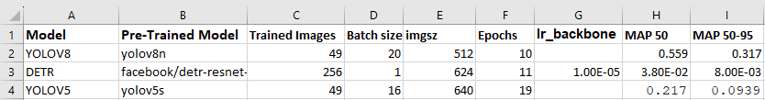
Model Accuracy Comparison

Slide 16
Best Model – YOLOV8
Got better accuracy among all the models that I have tried
It is also latest model compared to others
YOLOv8, have its modifications or enhancements in architecture compared to YOLOv5. The performance improvements or specific changes might vary based on the modifications made.
Notes:
Why Random Forest Regression is good?
A Random Forest Regression model is powerful and accurate. It usually performs great on many problems, including features with non-linear relationships
How is XGBoost different from random forest?
One of the most important differences between XG Boost and Random forest is that the XGBoost always gives more importance to functional space when reducing the cost of a model while Random Forest tries to give more preferences to hyperparameters to optimize the model..
n_estimators — the number of decision trees you will be running in the model

Slide 17
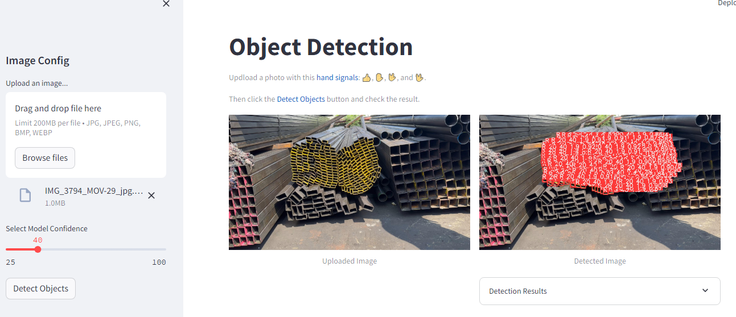
Screen shot of output using Streamlit

Slide 18
Challenges
Annotating such large dataset of images
Getting imbalanced classes of data for the annotated images
Facing runtime error while training the model
Getting a generalized model with high accuracy

Slide 19
Future Scopes
Improving models Accuracy by monitoring how the model is performing.
Improving models Accuracy by adding more data.
By Tuning Hyperparameters we can get a more generalized model.

Slide 20
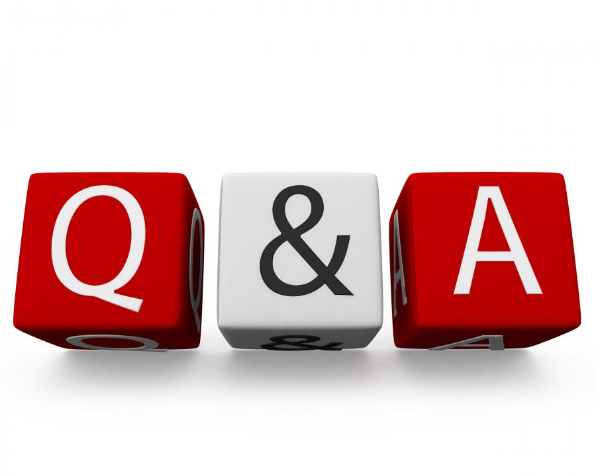
Queries ?

Slide 21


